Slide 1
Betfair Explained
Robert Linsley, Head of Analytics and Insight

Slide 2

Betfair
Introduction
Betfair is a betting exchange - an online marketplace for punters to bet between themselves on sporting and cultural events around the world.
Customers bet against each other not against Betfair.

Slide 3
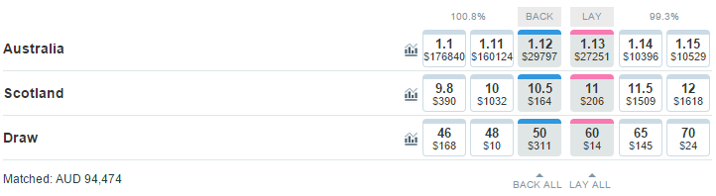
Betfair
Introduction
Unlike traditional bookmakers on Betfair you can back (buy) and lay (sell).
Laying is taking the traditional bookmakers viewpoint i.e. that a selection won’t win.

Slide 4
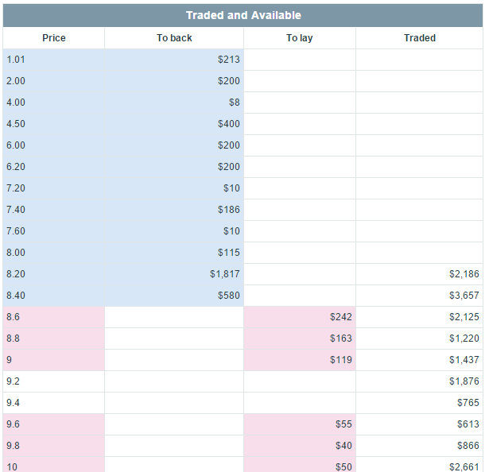
Betfair
Introduction
As well as taking prices customers can ‘make offers’ and request better prices.
Like a stock market this leads to market depth on both the buy and sell side.

Slide 5
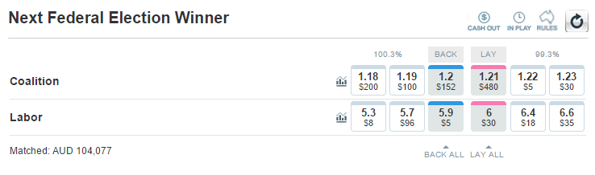
Betfair
Introduction
Unlike bookmakers, who build a margin into their prices, Betfair charges commission on winnings.
This means our prices are much closer to the true implied probability of each outcome.
83.33% Chance
16.95% Chance
100.3% Chance

Slide 6
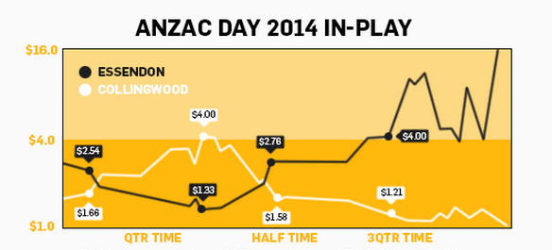
Betfair
Introduction
Our markets also run ‘In Play’ and customers can trade opinions throughout the event.

Slide 7
Betfair
Introduction
So why is our data so unique??!!
Peer to Peer opinions
Ability to bet against outcomes occurring
Prices created by customers
No margin, prices are close to true implied probability
Trading continues In Play

Slide 8
Our Data

Slide 9
Our Data
The data provided contains every transaction from this year’s Cricket World Cup match odds markets.
Due to the high trading nature of our Exchange which runs In Play we amassed 3.9m transactions…
…from 24k customers based in 70 different countries.

Slide 10
Our Data
Example
Every Matched Bet will have an equivalent bet the other side of the Market.
BET_ID | MATCH_BET_ID | ACCOUNT_ID | MATCH | EVENT_NAME | BID_TYP | STATUS_ID | SELECTION_NAME | PRICE_TAKEN | BET_SIZE | PROFIT_LOSS
4865425046 | 4865426811 | 8971997 | Sri Lanka v South Africa | Match Odds | B | S | South Africa | 1.22 | 100.00 | 22.00
4865426811 | 4865425046 | 1664479 | Sri Lanka v South Africa | Match Odds | L | S | South Africa | 1.22 | 100.00 | -22.00

Slide 11
Our Data
Identifiers
Each transaction has the following unique IDs:
Column | Example | Comment?
BET_ID | 4887737237 | Bet Group ID
BET_TRANS_ID (PK) | 6053588011 | Unique Transaction Identifier
MATCH_BET_ID | 4887737240 | Corresponding Match Bet
ACCOUNT_ID | 1012952 | Customer Identifier
PARENT_EVENT_ID | 27402533 | Parent Event Identifier
EVENT_ID | 101187943 | Event Identifier

Slide 12
Our Data
Date Fields
Each transaction has the following Dates/Times:
Column | Example | Comment?
EVENT_DT | 24/03/2015 1:00:00 AM | Scheduled Event Start
OFF_DT | 24/03/2015 1:00:00 AM | Actual Event Start
PLACED_DATE | 24/03/2015 1:00:00 AM | Bet Placement Date
TAKEN_DATE | 24/03/2015 1:00:00 AM | Bet Match Date
SETTLED_DATE | 24/03/2015 1:00:00 AM | Bet Settled Date
CANCELLED_DATE | 24/03/2015 1:00:00 AM | Bet Cancelled Date
A Lapsed bet will not have a taken date or a cancelled date.

Slide 13
Our Data
Text Fields
Each transaction has the following Text fields:
Column | Example | Comment?
COUNTRY_OF_RESIDENCE_NAME | Australia | Customer Residence
MATCH | NZ vs Australia | The Match
EVENT_NAME | Match Odds | The Market
SELECTION_NAME | Australia | The Selection Bet on

Slide 14
Our Data
Transactional Metrics
Each transaction has the following transactional metrics:
Column | Example | Comment?
BET_PRICE | 2.32 | Requested Price
PRICE_TAKEN | 2.34 | Matched Price
BET_SIZE | 200 | Stake
PROFIT_LOSS | -200 | Outcome

Slide 15
Our Data
Other Fields
Each transaction has some other important fields:
Column | Example | Comment?
BID_TYP | L | Back or Lay
STATUS_ID | S | Bet Status
PERSISTENCE_TYPE | IP | Keep Bet Inplay
INPLAY_BET | Y | Inplay Bet

Slide 16
Resources
Me and my team (Robert.Linsley@Betfair.com.au)
https://www.betfair.com.au/hub/

